Slide 1
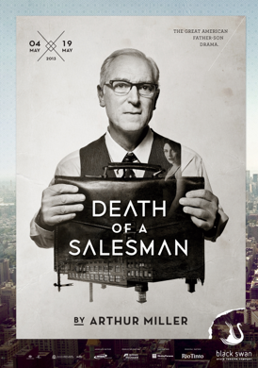
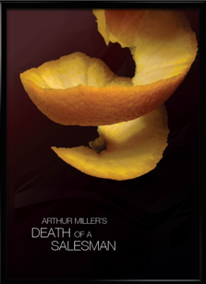
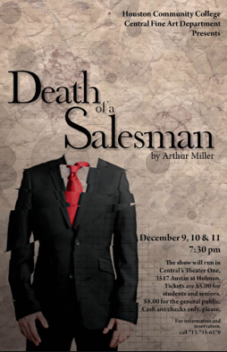
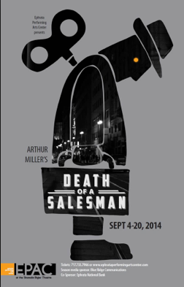
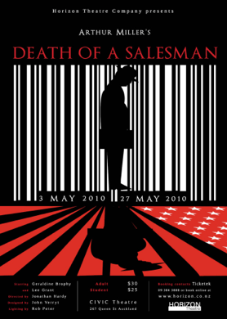
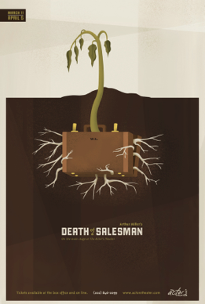
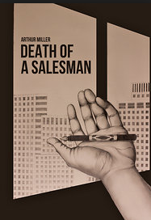
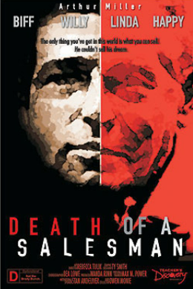
Death of a Salesman in production (1949--2015)

Slide 2
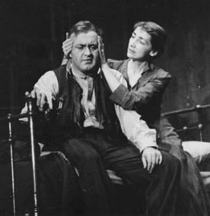
1949 Broadway Premier with Lee J. Cobb
Cobb (37)
Dunnock (48)

Slide 3
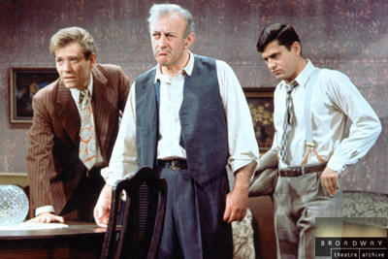
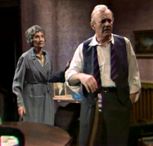
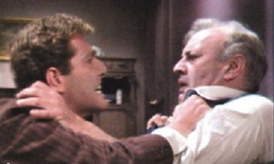
Lee J. Cobb (54)
in 1966 television
version:
With: Mildred Dunnock (65)
George Segal (Biff)
James Farentino (Happy)
and Gene Wilder (Bernard)

Slide 4
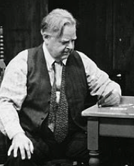
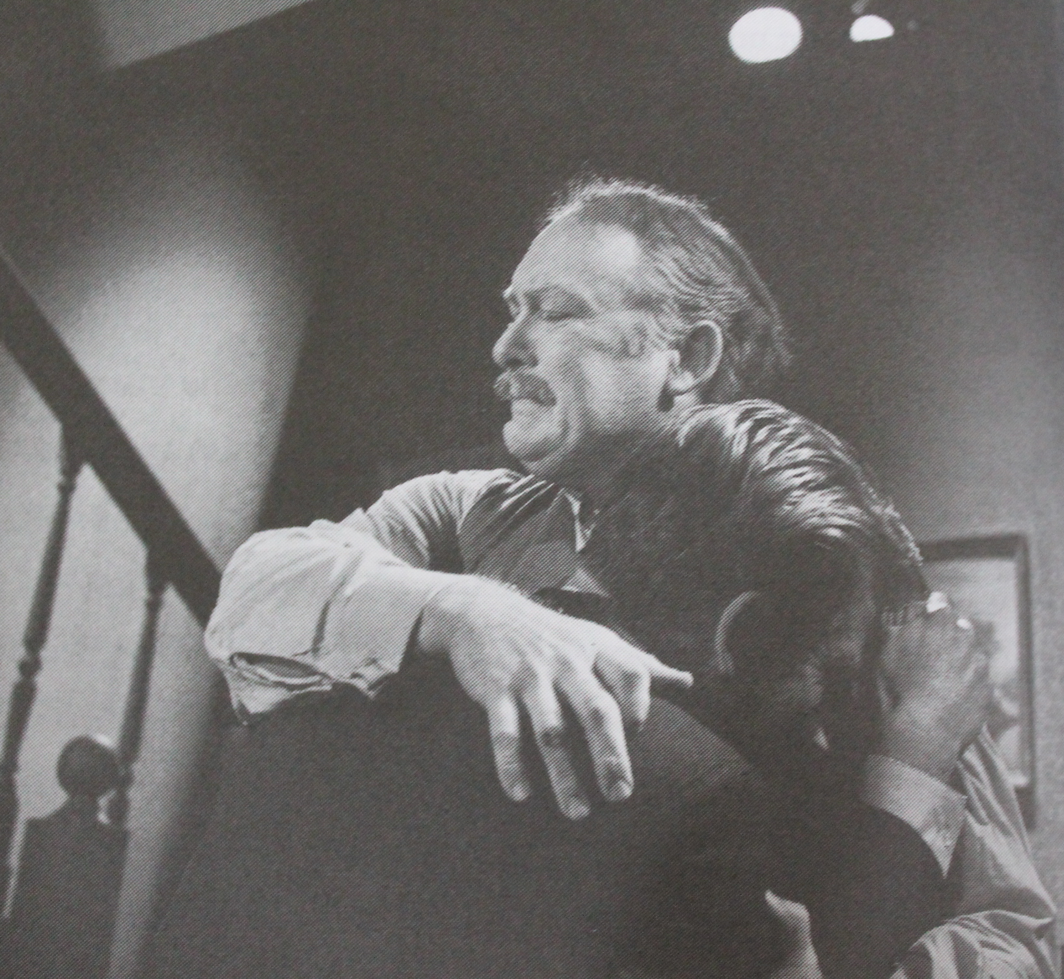
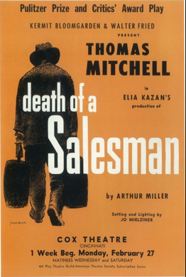
After Cobb:
Albert Dekker (45)
May-Aug. 1950
Gene Lockhart (59)
Nov. 1949-April 1950)
Thomas Mitchell (58)
Sept.-Nov. 1950
Rod Steiger (40) 1966
Dekker (53) in 1958 CBC version

Slide 5
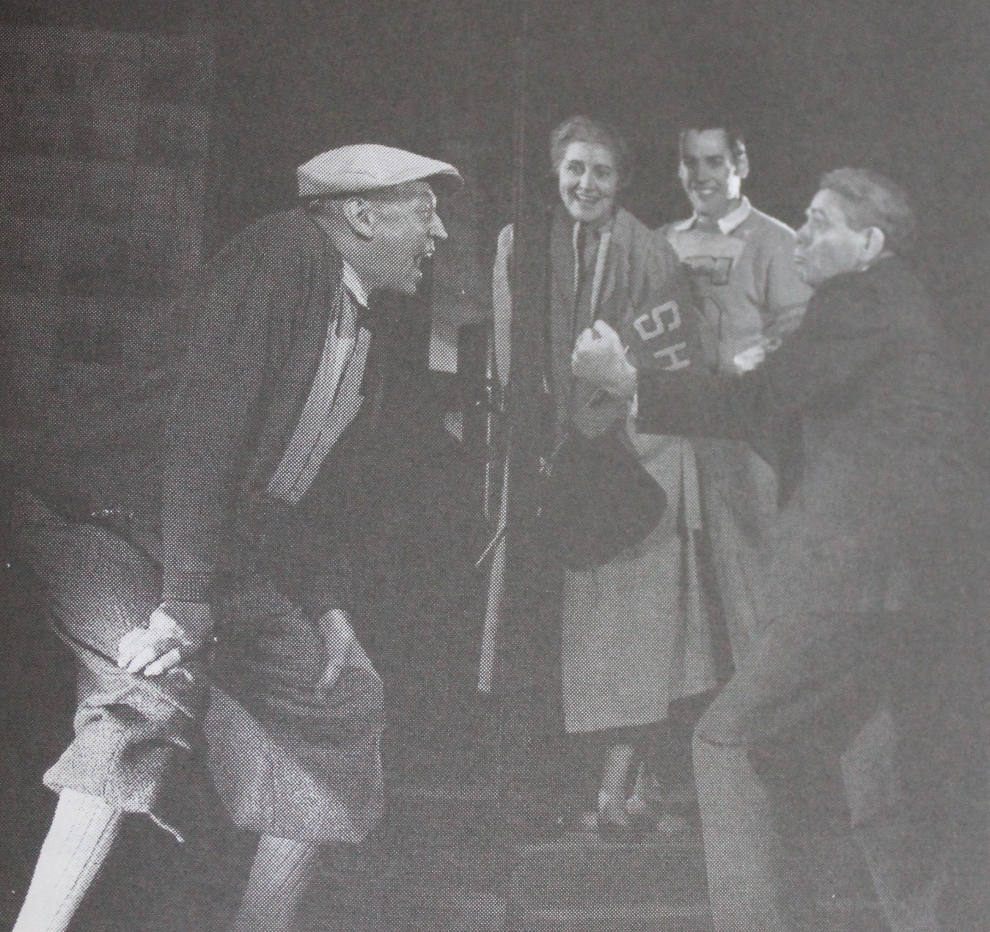
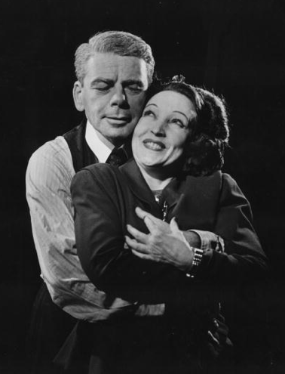
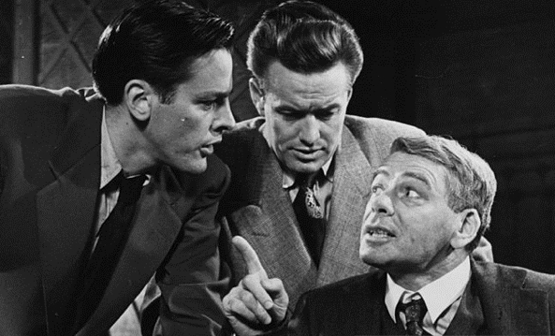
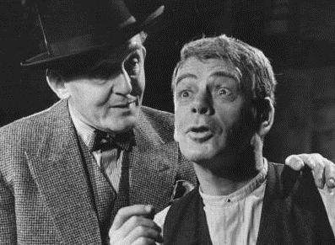
Paul Muni (53): London Premier 1949

Slide 6
1951 film: screenplay by Stanley Roberts
Directed by Laslo Benedek

Slide 7
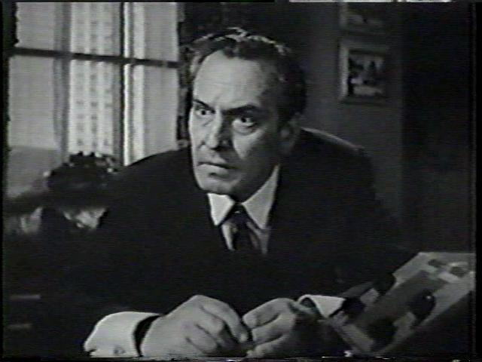
Fredric
March
(53)

Slide 8
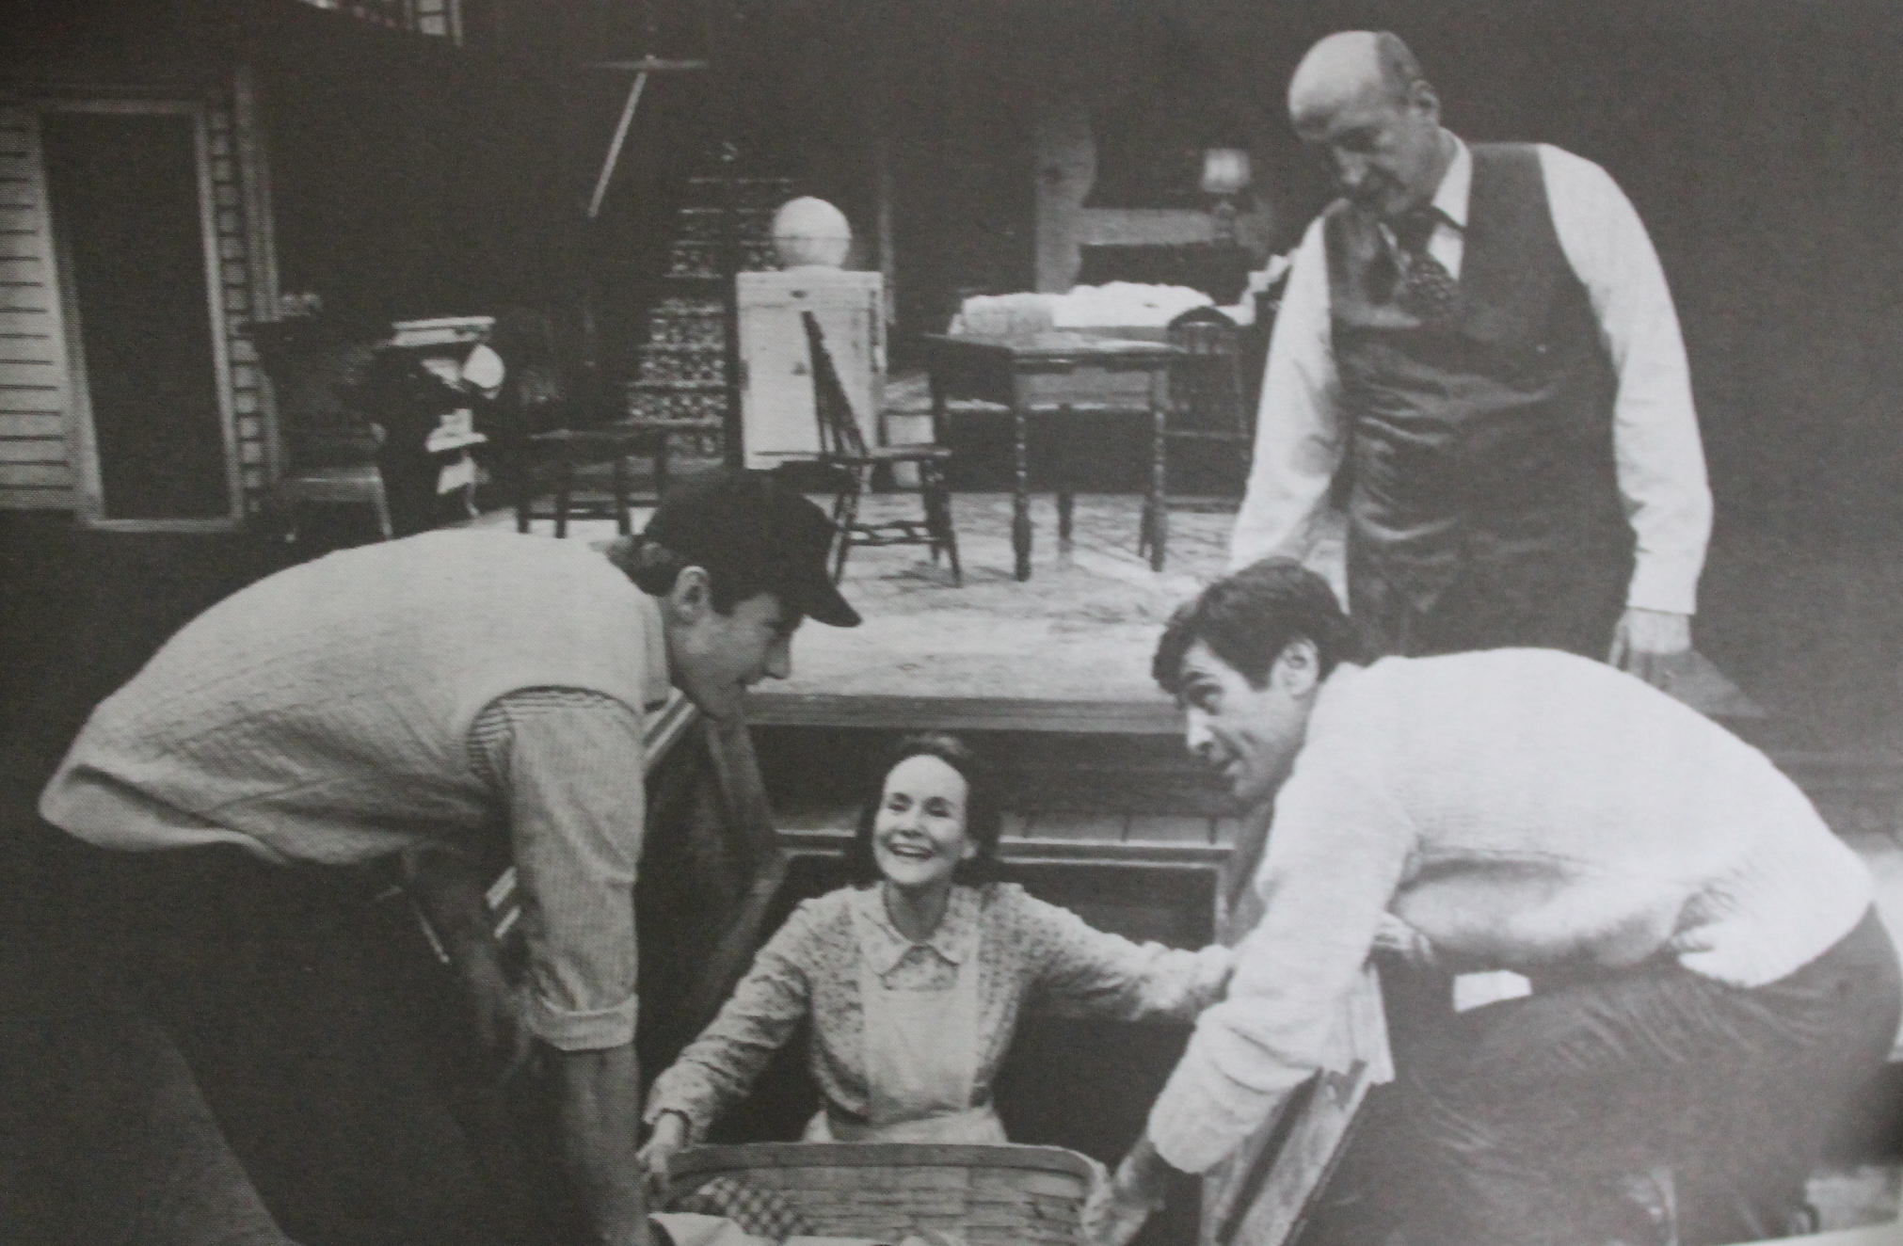
George C. Scott (47) Circle-in-the Square 1975

Slide 9
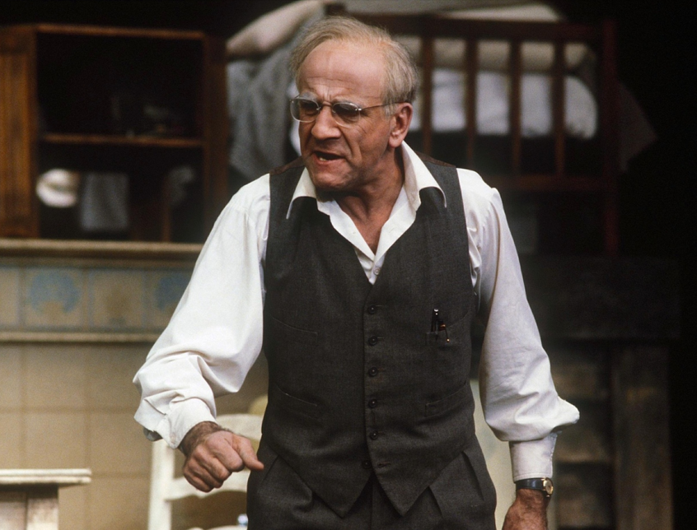
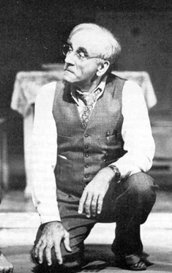
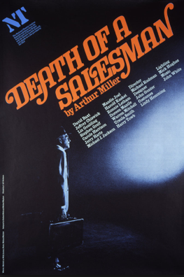
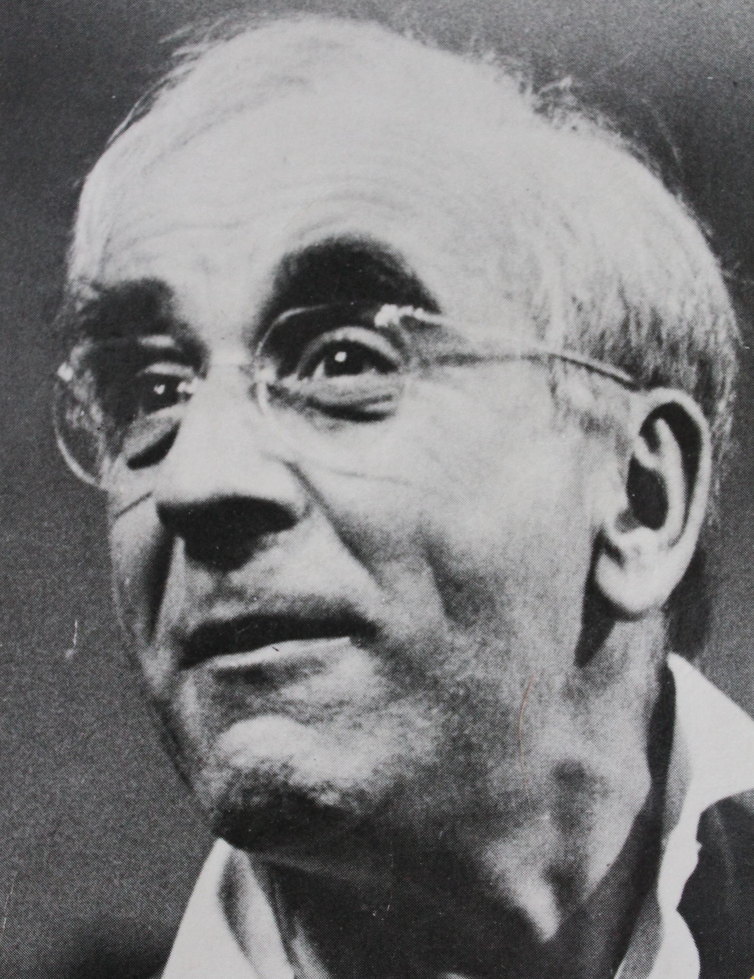
Warren Mitchell (53)
National Theatre,
London 1979

Slide 10
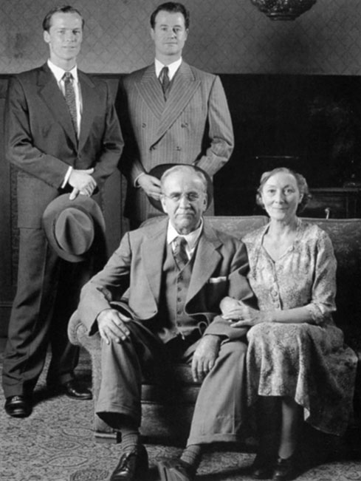
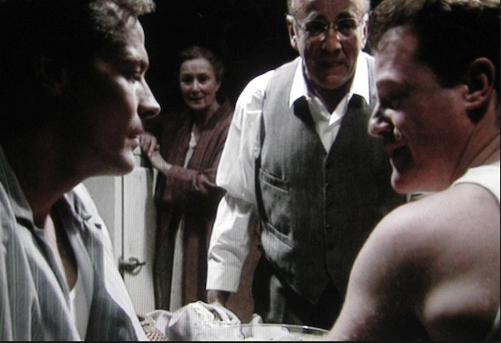
Mitchell (70):
1996 television

Slide 11
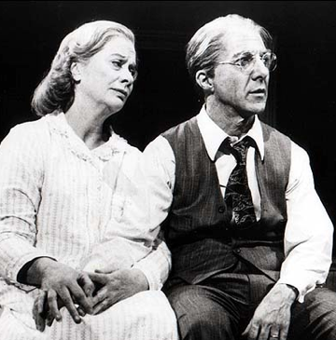
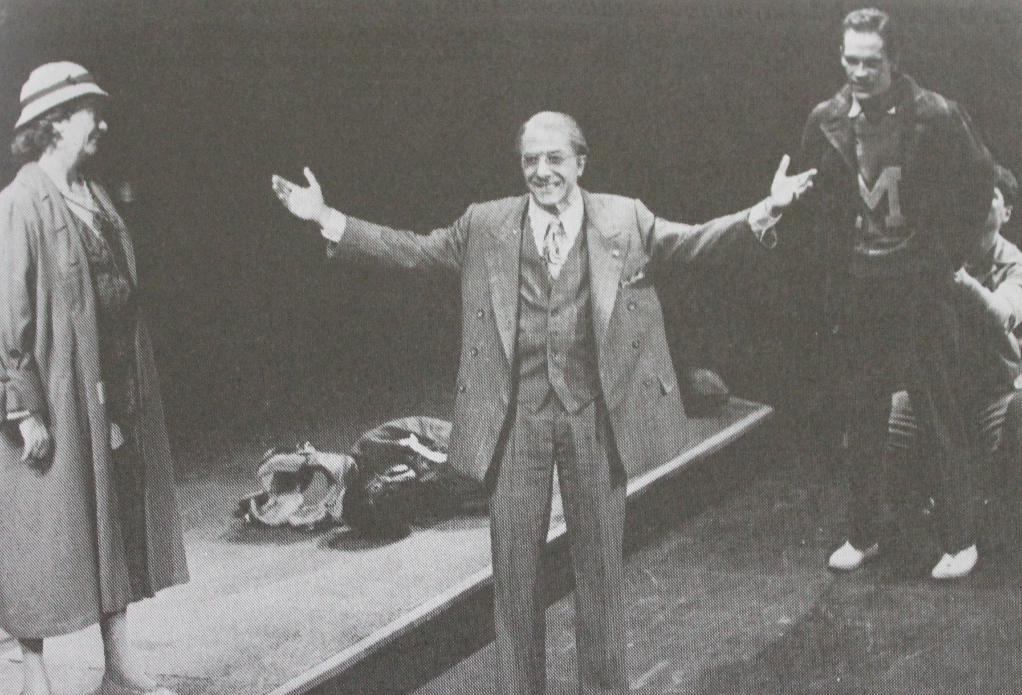
Dustin Hoffman (46)
Broadway 1984:

Slide 12
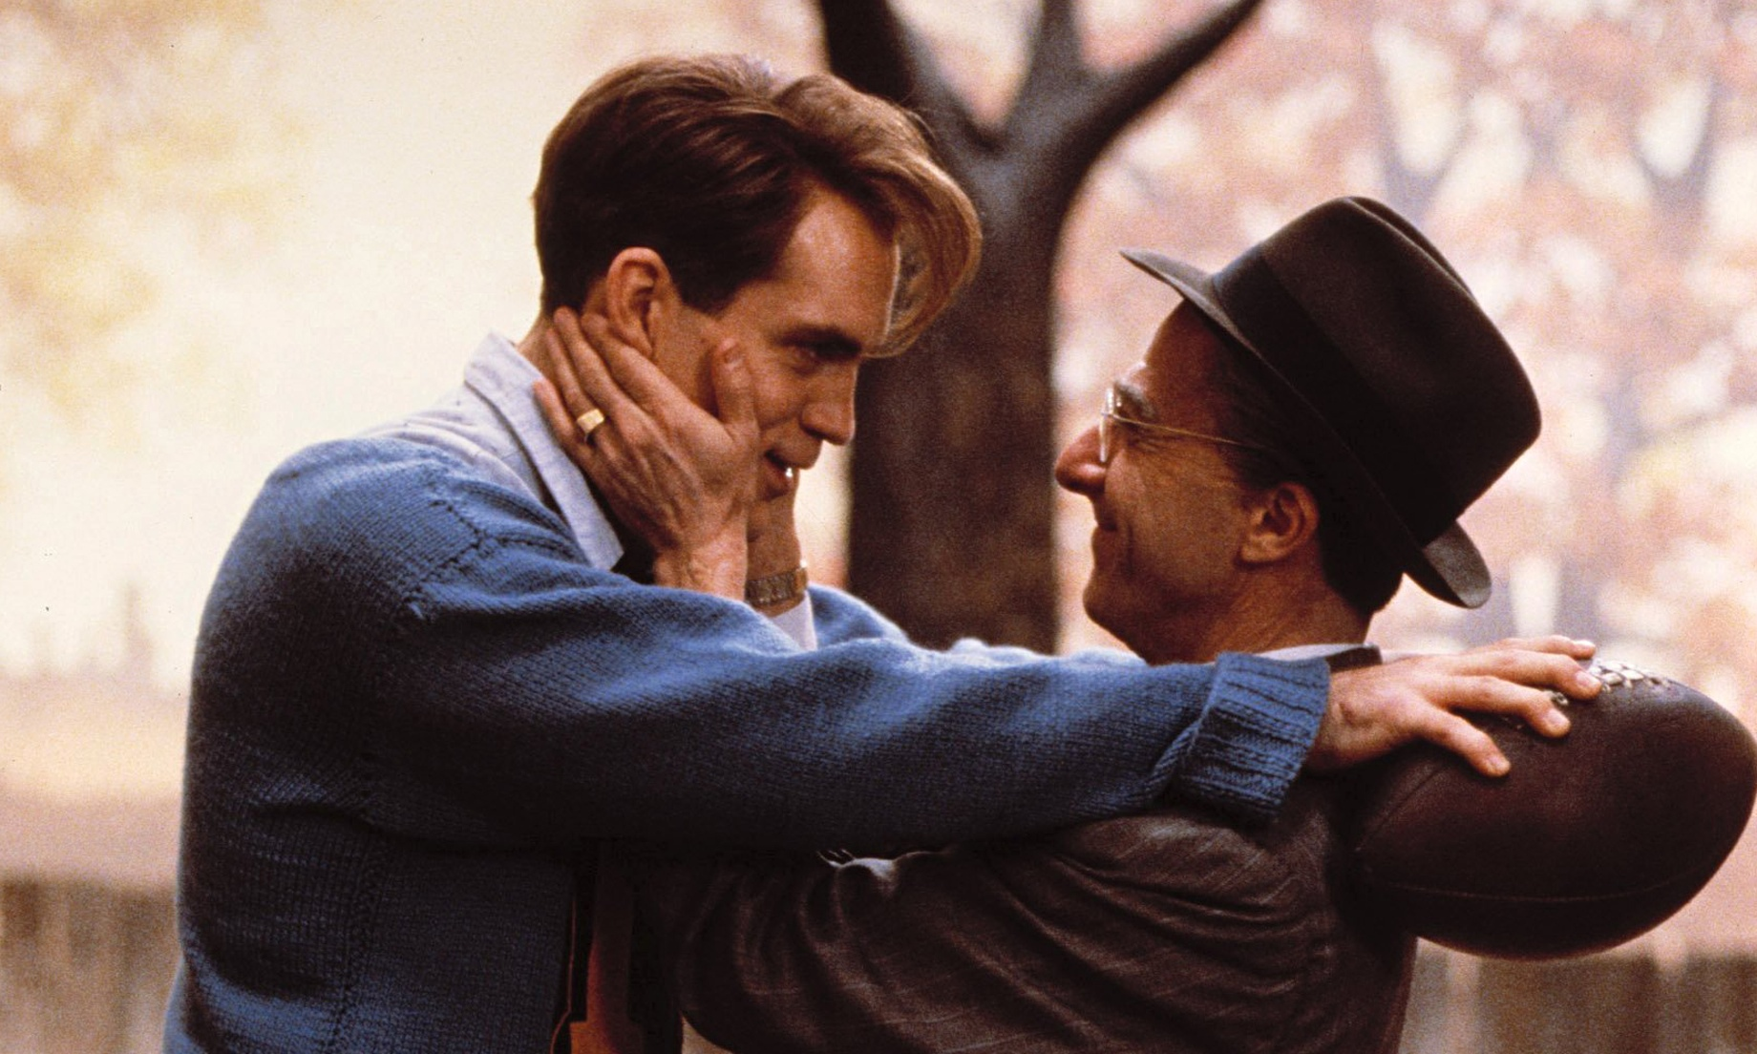
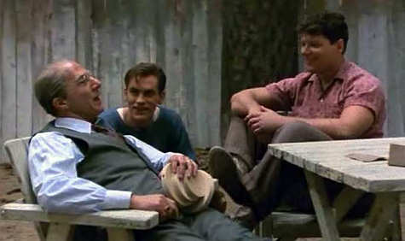
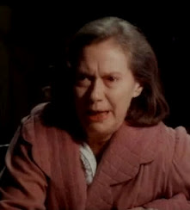
1985 CBS
television

Slide 13
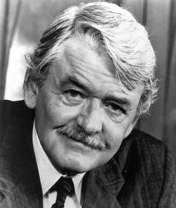
Hal Holbrook (70)
7 city tour in 1996
With Elizabeth Franz as Linda

Slide 14
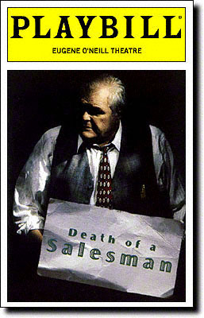
Brian Dennehy (60)
Broadway 1999

Slide 16
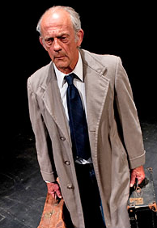
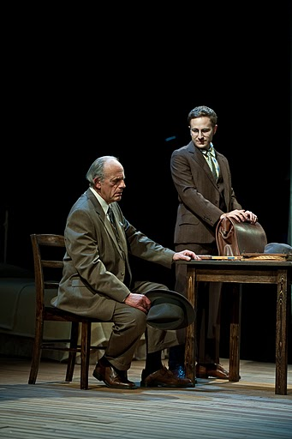
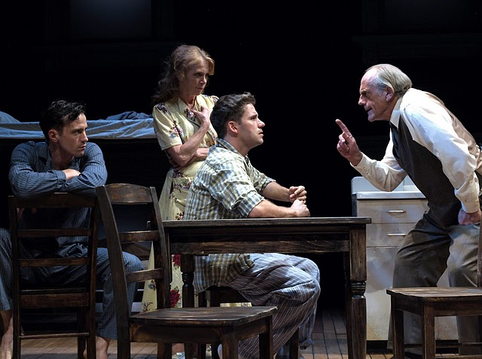
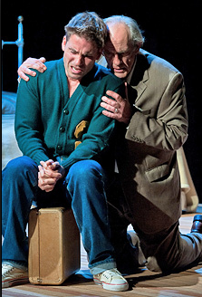
Christopher Lloyd (72)
Weston Playhouse 2010

Slide 17
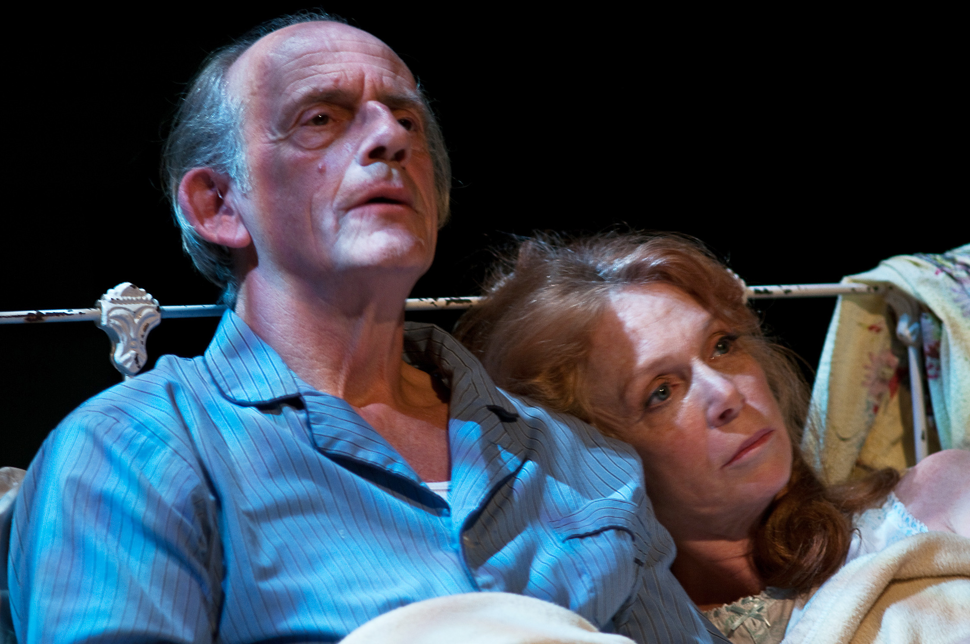
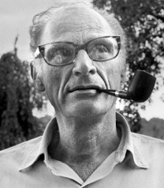

Slide 18
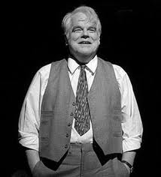
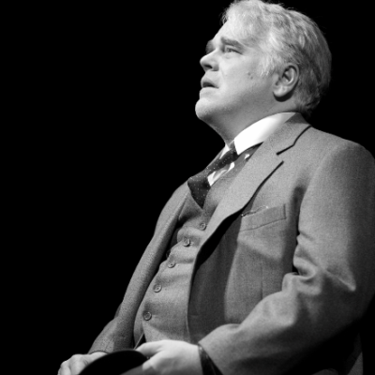
Philip Seymour Hoffman (44) Broadway 2012

Slide 19
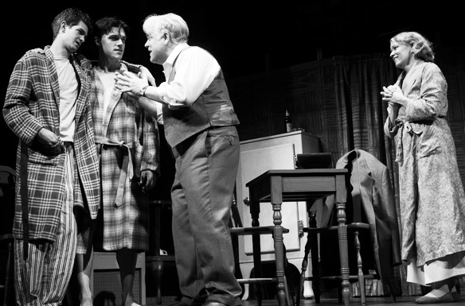
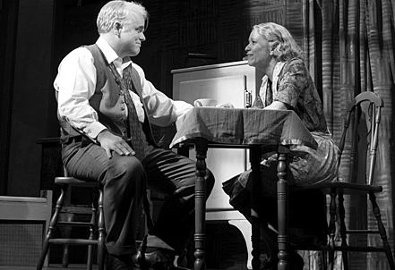
N.B. how often he is sitting!
All
B/W
photos

Slide 20
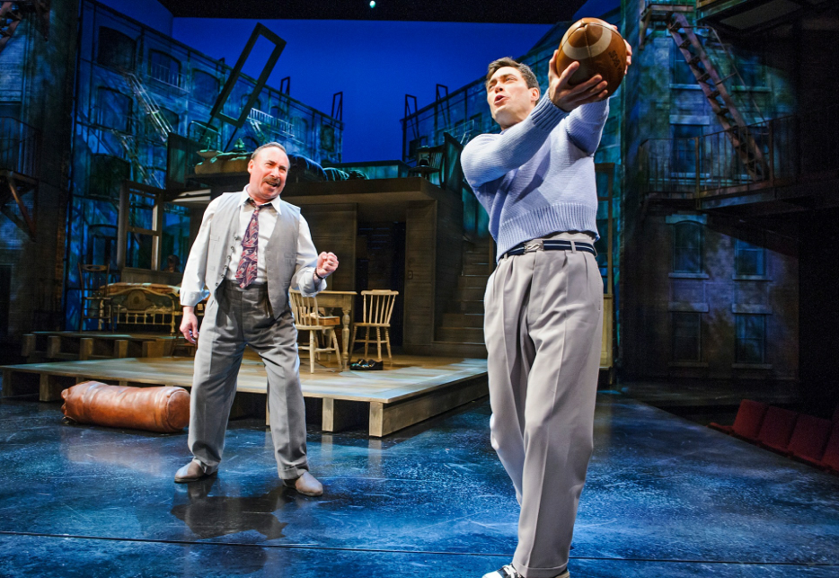
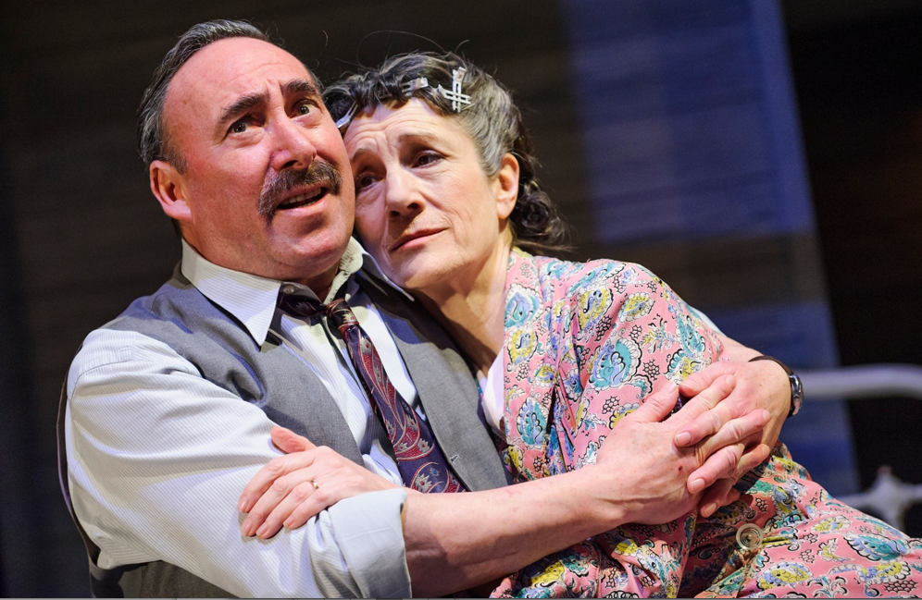
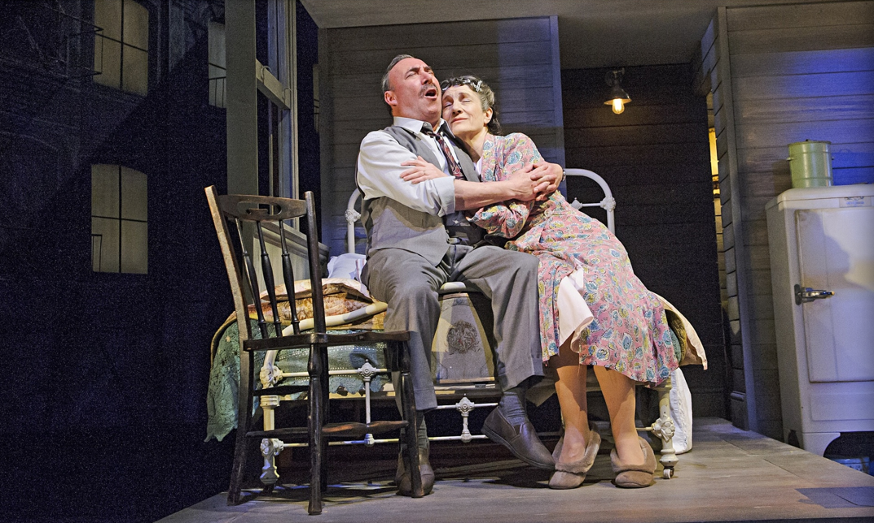
Harriet Walters as Linda
Royal
Shakespeare
Company
2015
with Antony Sher

Slide 21
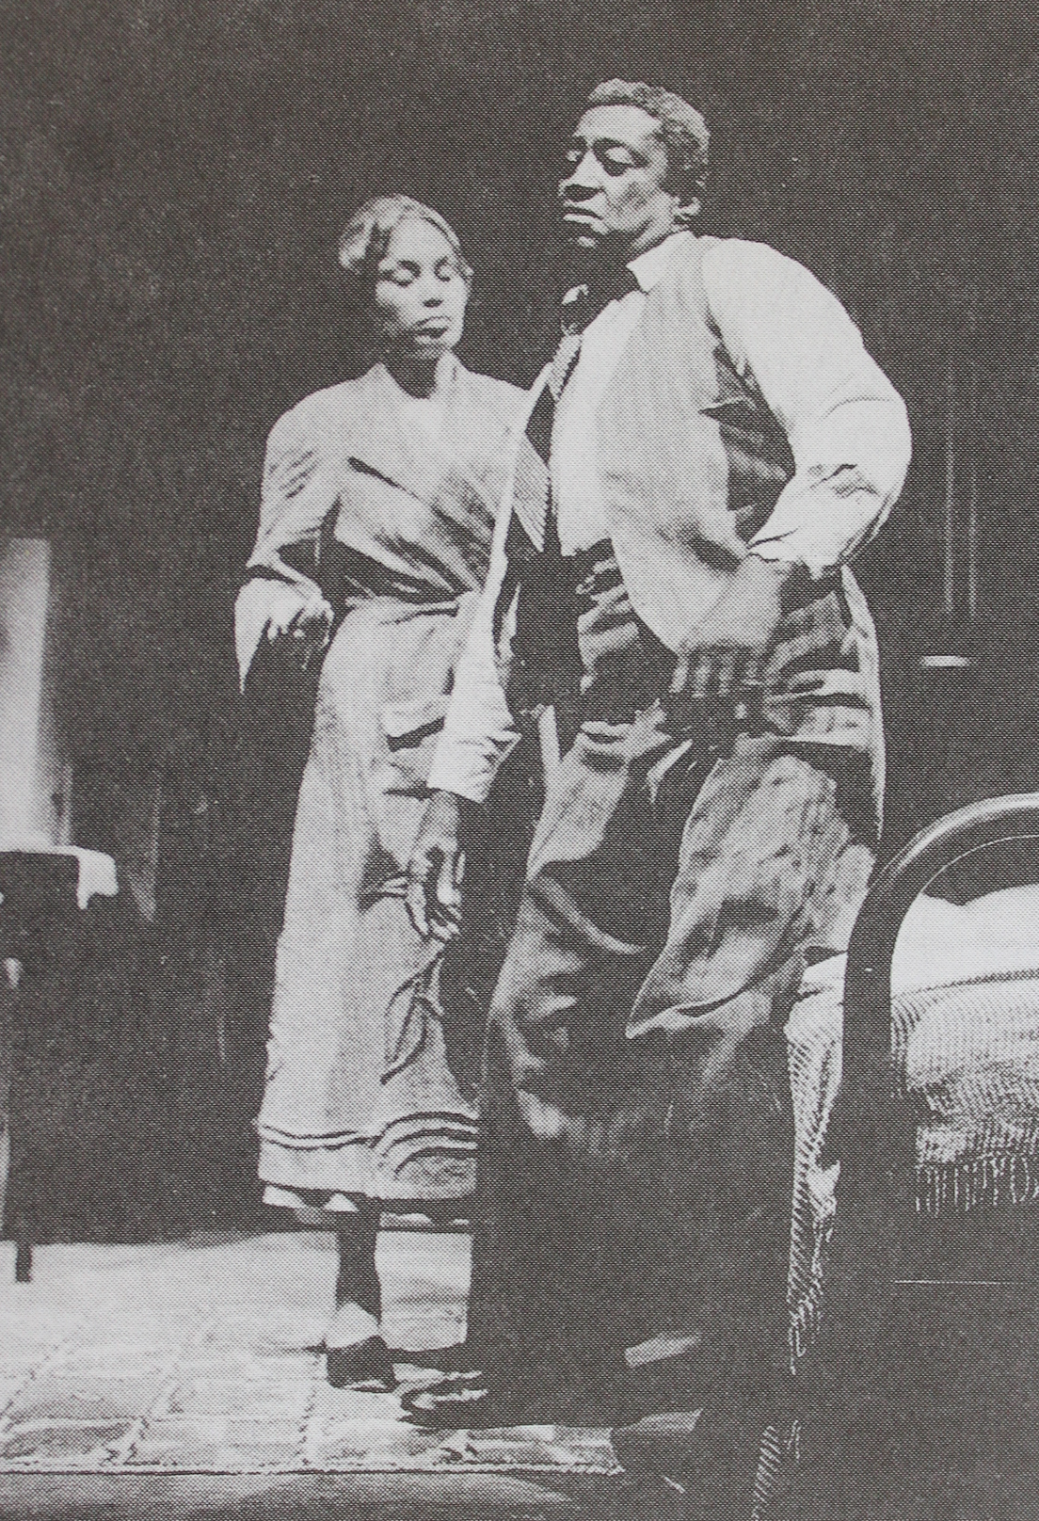
All Black casts:
Richard Ward
1972
Center Stage
Baltimore
Charles S. Dutton
2009
Yale Rep

Slide 22
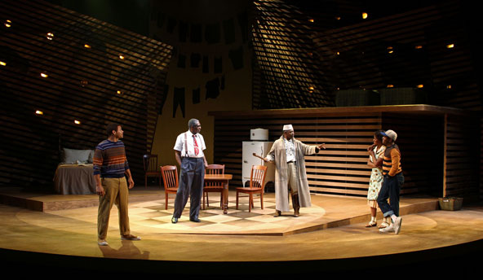
Charlie Robinson (2013)
Keith “Kash” Goins (2014)
South Coast Repertory Theatre production 2013

Slide 23
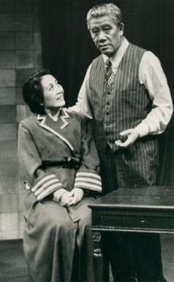
Salesman in Beijing 1983

Slide 24
Ying
Roucheng
as Willy

Slide 25
Other Asian productions: Korea, China, US
Ding Zhicheng
Vishaal Reddy
Always Love Lucy productions (2014)

Slide 29
Mielziner inspired:
Eastern Illinois University 1965
Muddy Waters 2008

Slide 30
Guthrie Theatre has
mounted 3 productions
of Salesman
The first was in 1963
with Hume Cronyn (52)
and Jessica Tandy (54)
Guthrie’s 2004
Open stage design

Slide 31
In the round:

Slide 32
Skeletal framing:

Slide 33
Using
Frames!

Slide 34
Minimal/Budget productions:
Left: Covina, CA and Always Love Lucy, NYC
Right: Lyric Arts, MN, and Thunder River, CO

Slide 35
Checkered flooring:

Slide 36
Poetic imagery
of David Thacker’s
1996 production
at National Theatre
London
with Alun Armstrong
as Willy.

Slide 37
…and checkered wallpaper!

Slide 38
A little more complex:

Slide 39
Even more complex:

Slide 40
Most complex!

Slide 41
Various representational:

Slide 42
Indiana Repertory Theatre
2007 off-kilter design:

Slide 43
Note the backdrop shadow (and red checkered flooring)!

Slide 44
Thompson River University’s giant head!

Slide 45
Theatre Mitu: highly representational production

Slide 46
Modern sets:

Slide 47
Lyric Theatre
Boston 2014

